Slide 1
Understanding Environmental Pollution
Causes, Effects, and Solutions

Slide 2
Introduction to Environmental Pollution
What is Environmental Pollution?
Contamination of the environment by harmful substances or activities.
Impacts air, water, soil, and ecosystems.
Types of Pollution:
Air Pollution
Water Pollution
Soil Pollution
Noise Pollution
Importance of Addressing Pollution:
Protects biodiversity, human health, and future generations.

Slide 3
Causes of Environmental Pollution
Industrial Emissions: Factories releasing smoke and chemicals.
Transportation: Vehicle exhaust contributes to air pollution.
Deforestation: Leads to loss of vegetation and soil erosion.
Waste Mismanagement: Plastic and toxic waste in water and soil.
Agricultural Practices: Pesticides and fertilizers contaminating the environment.
Visual: Diagram linking human activities to pollution types.

Slide 4
Effects of Environmental Pollution
Impact on Health:
Respiratory diseases, cancers, and other health issues.
Impact on Nature:
Ecosystem destruction, wildlife extinction.
Climate Change:
Greenhouse gases causing global warming.
Water and Food Security:
Contaminated water and crops.
Visual: A before-and-after image of an affected area (e.g., forest to wasteland).

Slide 5

Video

Slide 6
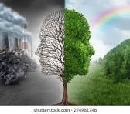
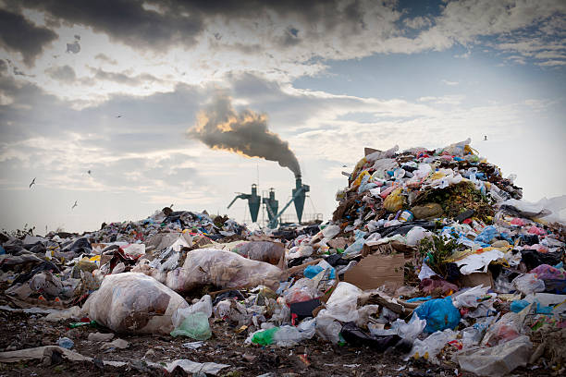
Environment Polluition Related Picture

